Slide 1

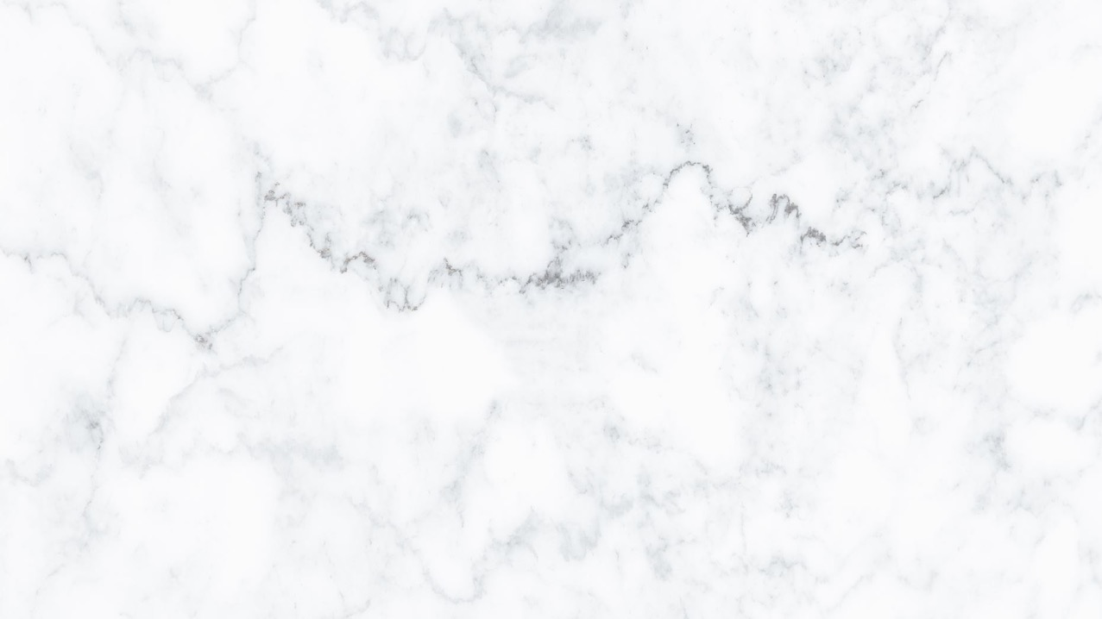
3D Graphics
Workshop 15 – Coursera week 18

Slide 2
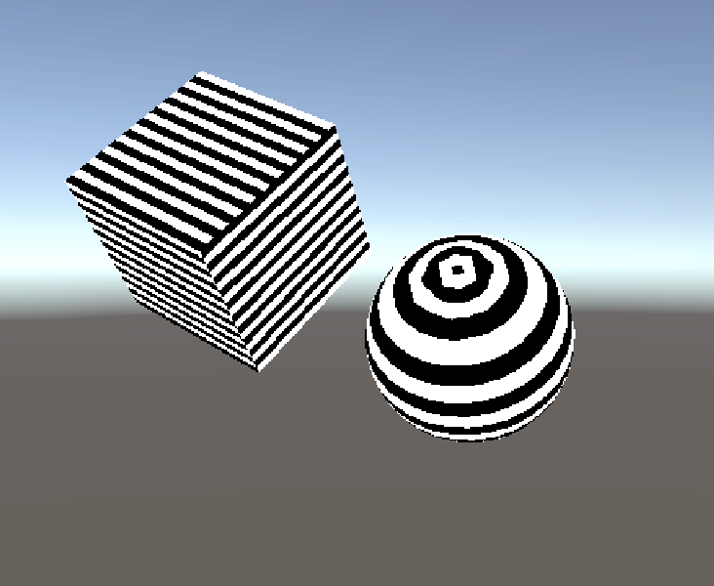
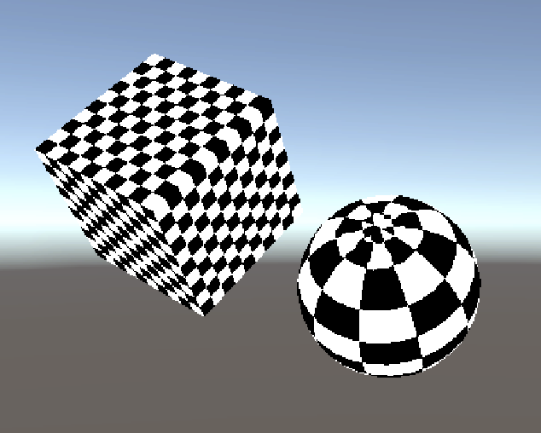
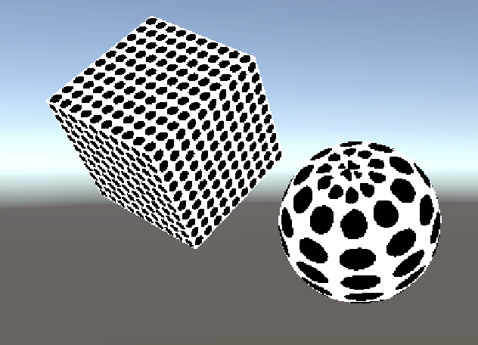
Procedural Texture
Procedural textures
Calculated mathematically to provide realism at any resolution

Slide 3
Procedural Texture
Imagine a fragment on the polygon.
The fragment has it’s own unique uv values.
All the fragments have the same common values.
Then how can that fragment decided what colour it should be ?
Need to work out an algorithm based on the above constraints.
Such “constraints” are due to the fact that the fragment are processed by a “GPU” which is parallel in nature.

Slide 4
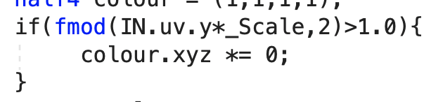
Stripes Shader
Basic idea
If the remainder of (y*scale)/2 is more than 1.0, shade black, else white

Slide 5
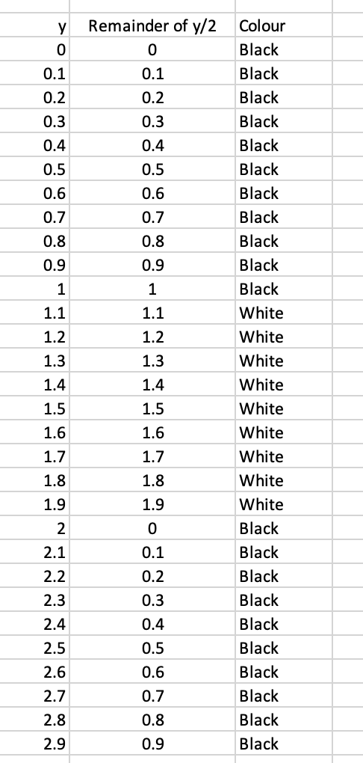
Stripes Shader
Basic idea
If the remainder of (y*scale)/2 is more than 1.0, shade black, else white
Black Stripe
White Stripe
Black Stripe

Slide 6
Lab
Work on Workshop 15
implement the Stripe Shader.

Slide 7
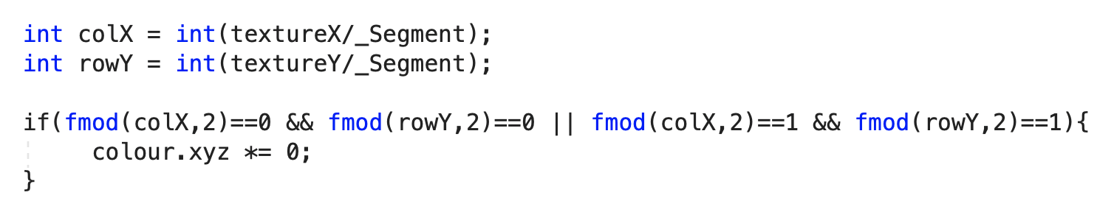
Checker Shader
Basic idea
If both x and y column number is even or odd, shade it black.
 | 0 | 1 | 2 | 3 | 4
0
1
2
3
4

Slide 8
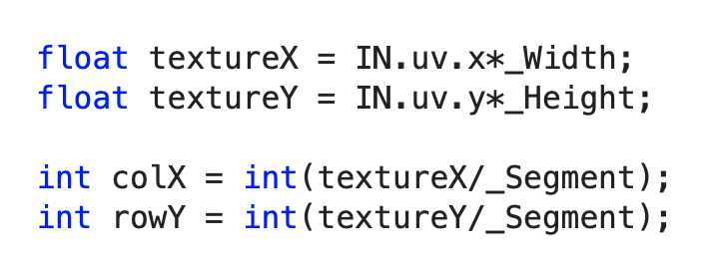
Checker Shader
Basic idea
Calculation of column and row number
Assume width and height is 100, segment is 5
uv value is in the range of 0 to 1.
if u value is 0.04, textureX is 4
Then colX is int(4/5) = 0
If u value is 0.06, textureX is 6
Then colX is int(6/5) = 1
If u value is 0.12, textureX is 12
Then colX is int(12/5) = 2
textureX
0 5 10 15 20
colX
0 1 2 3

Slide 9
Lab
Work on Workshop 15
implement the Checker Shader.

Slide 10
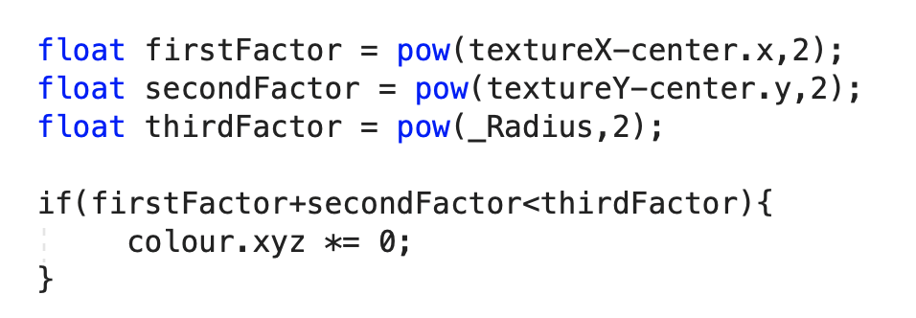
Dots Shader
Basic idea
Circle function
x² + y² = r²
For circle centre shifted by a and b (a and b is the centre of the circle)
(x-a)² + (y-b) ² = r²
Conditions.
If (x-a)² + (y-b) ² == r² (on the radius)
If (x-a)² + (y-b) ² < r² (in the circle, shade it black)
If (x-a)² + (y-b) ² > r² (outside the circle)

Slide 11

Dots Shader
Getting the circle centre of that fragment.
texture/_Segment is to get the column number
Multiple by _Segment to get the starting point of the segment
Add _Segment/2 to get the center.
Example:
Segment is 5 and textureX is 12
Int(texture/segment) = 2
2*segment = 10
10 + segment/2 = 12.5
textureX
0 5 10 15 20
colX
0 1 2 3

Slide 12
Lab
Work on Workshop 15
implement the Dots Shader.

Slide 13
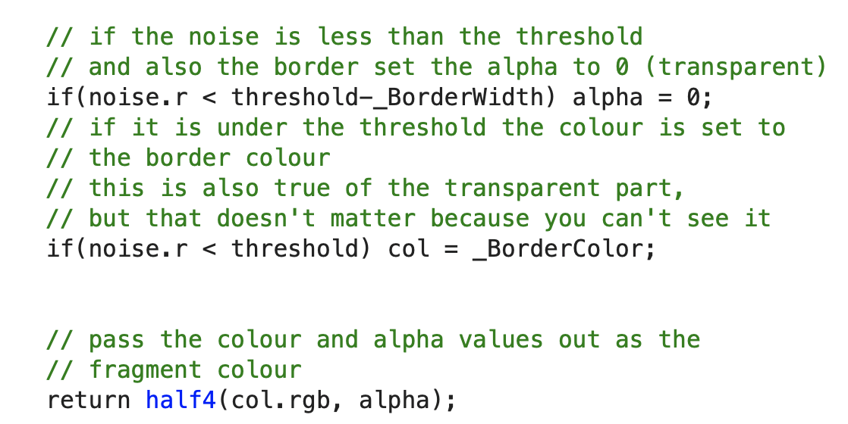
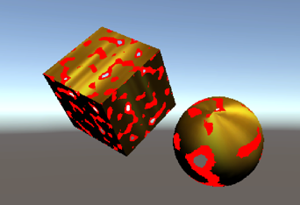
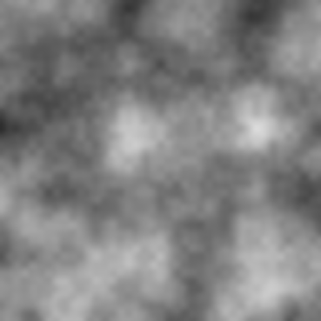
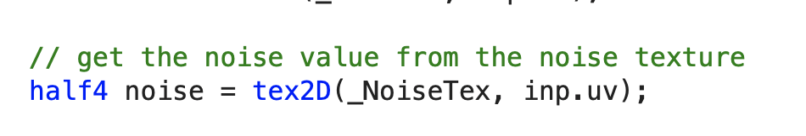
Teleport Shader
Uses Perlin noise value to change the alpha value of the fragment.
The Perlin noise value is embedded onto an image and passed in to the shader as a texture.

Slide 14
Lab
Work on Workshop 15
implement the Noise Shader.

